Slide 1

ARCHETYPES OF CHANGE
Presented by Octave Institute and
The Global Consciousness Institute
Judi Neal, Ph.D.
Co-sponsored by SUSS

Slide 2


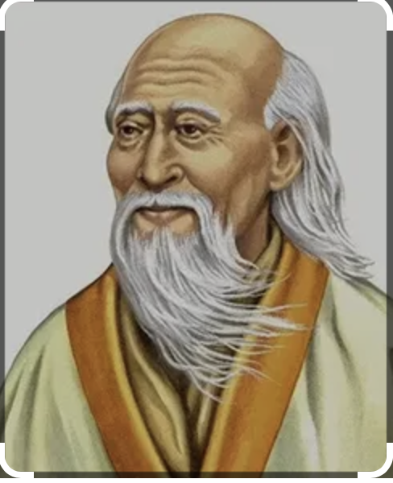

Lao Tzu
Life is a series of natural and spontaneous changes. Don’t resist them; that only creates sorrow.
Let reality be reality.
Let things flow naturally forward in whatever way they like.

Slide 3
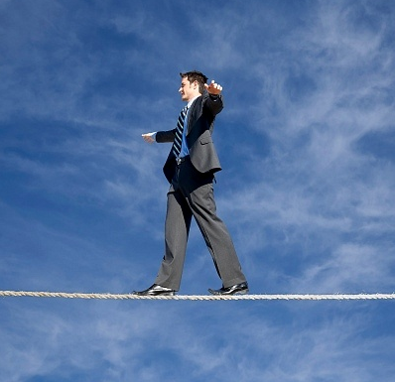
Agenda
Principles of Transformation
Force Field Analysis
Five Roles – The Archetypes
Breakout by Archetype
Breakout by Organization
Working with the Archetypes
Resources
Slides will be sent to you.

Slide 4






Slide 5
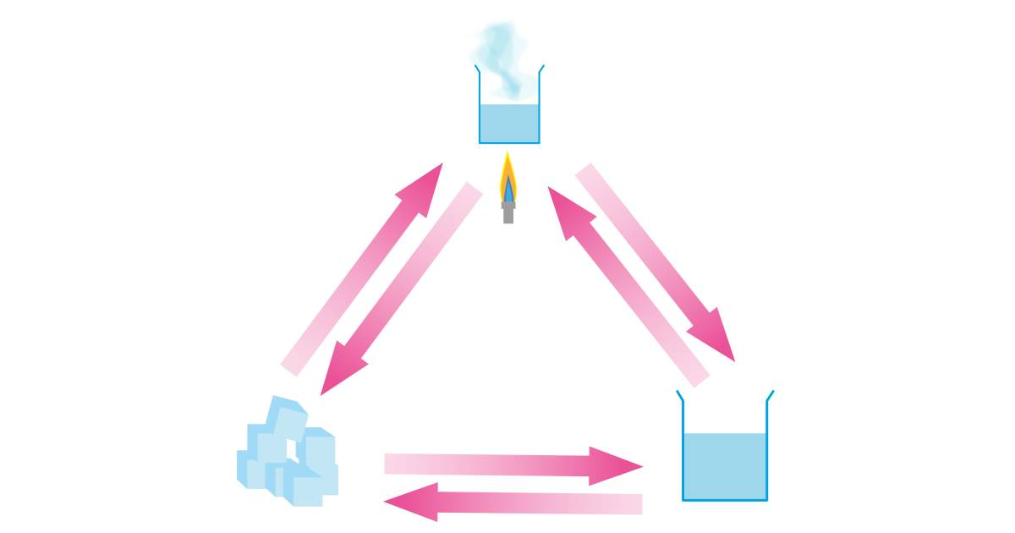
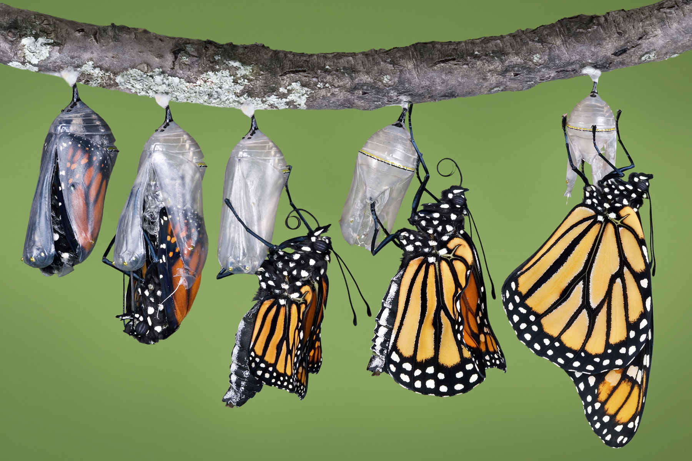
Change vs. Transformation

Slide 6
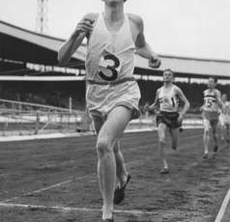
First Step in Transformation
BELIEF
  4-minute mile
  Placebo effect

Slide 7
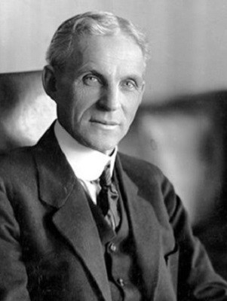
Henry Ford – Belief
“Whether you think you can or whether you think you can’t, you’re right.”

Slide 8
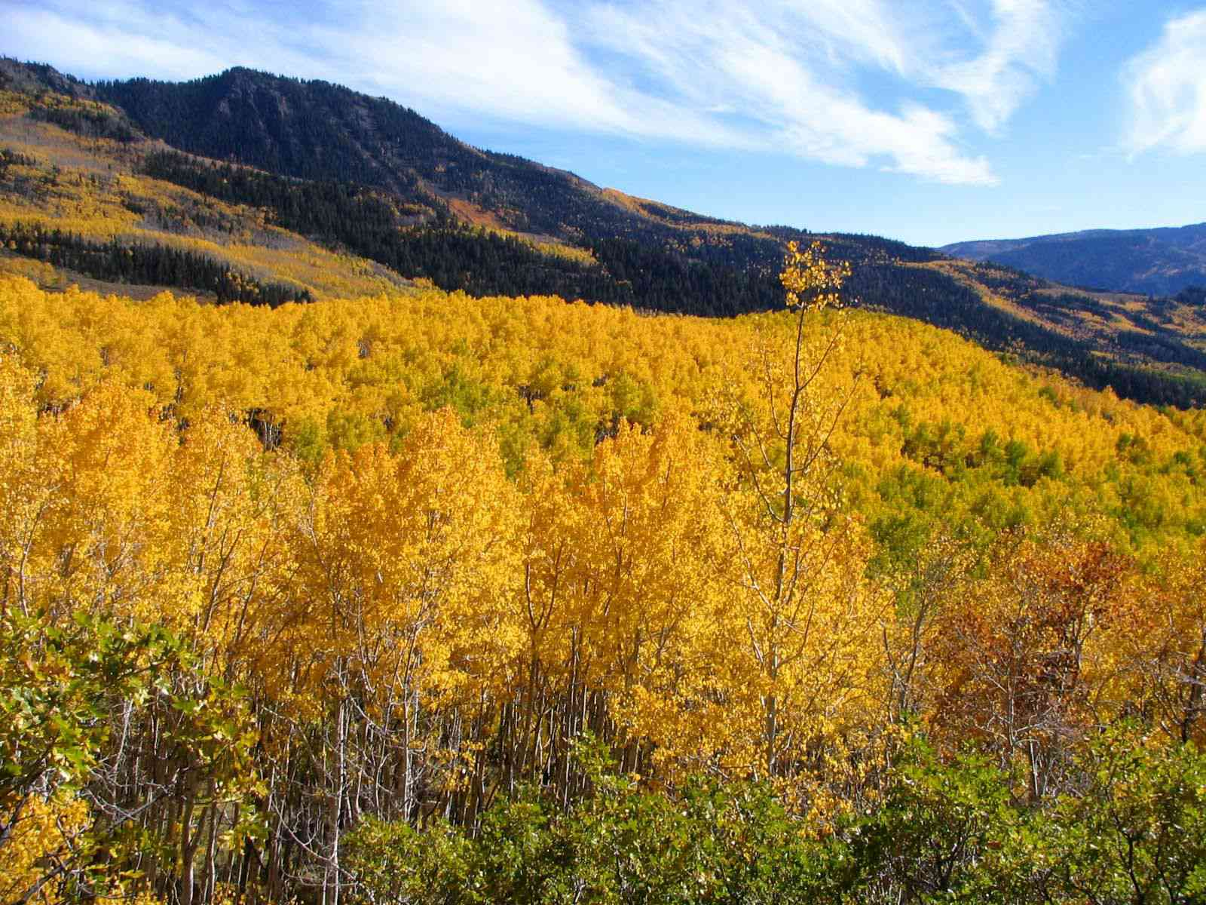
Living Systems -
Meg Wheatley
In nature, change never happens top-down
Emergence – “Change begins as local actions spring up simultaneously in many different areas.”
Organizations are living systems
Interconnection
Utah Aspen Grove
80,000 years old

Slide 9
A few key principles of transformation
No systems transformation without personal transformation
No organization can reach a higher level of consciousness than its top leader
Contemplative practice is central to personal transformation
Me – We - All
Breakdown to breakthrough
We are evolving
Quantum leaps – grace, magic, miracles
Vision and passion stronger than fear
What you pay attention to grows
  Appreciative Inquiry

Slide 10
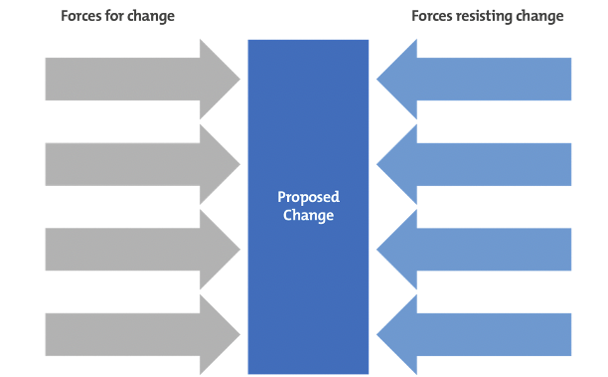
Exercise: Force Field Analysis

Slide 11
Steps
Define your vision for transformation - from Friday
Identify forces for change
  Internal/External
Identify forces resisting change
  Internal/External
Score each force 1-5 (weak to strong)
Source: https://www.mindtools.com/a23ewmr/force-field-analysis

Slide 12
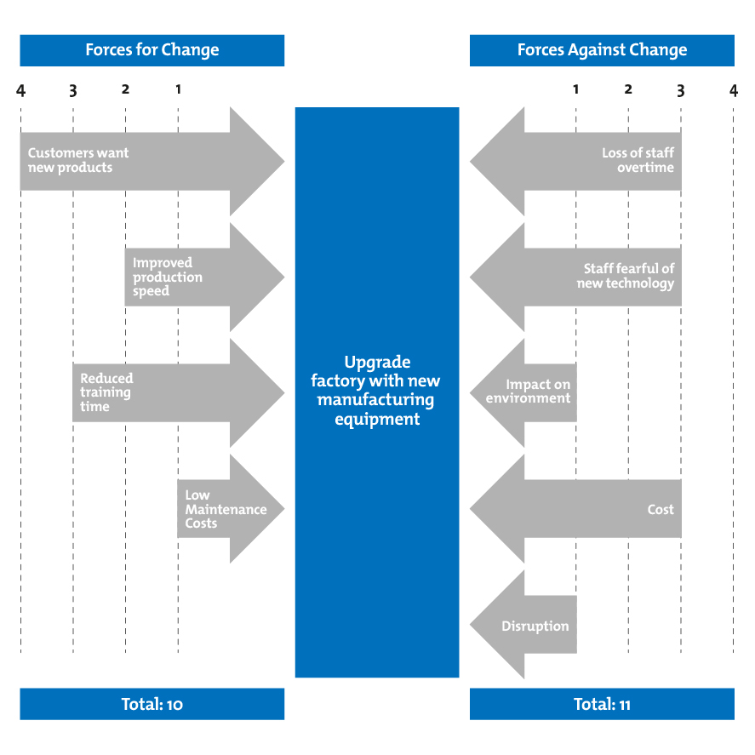
Exercise: Force Field Analysis

Slide 13
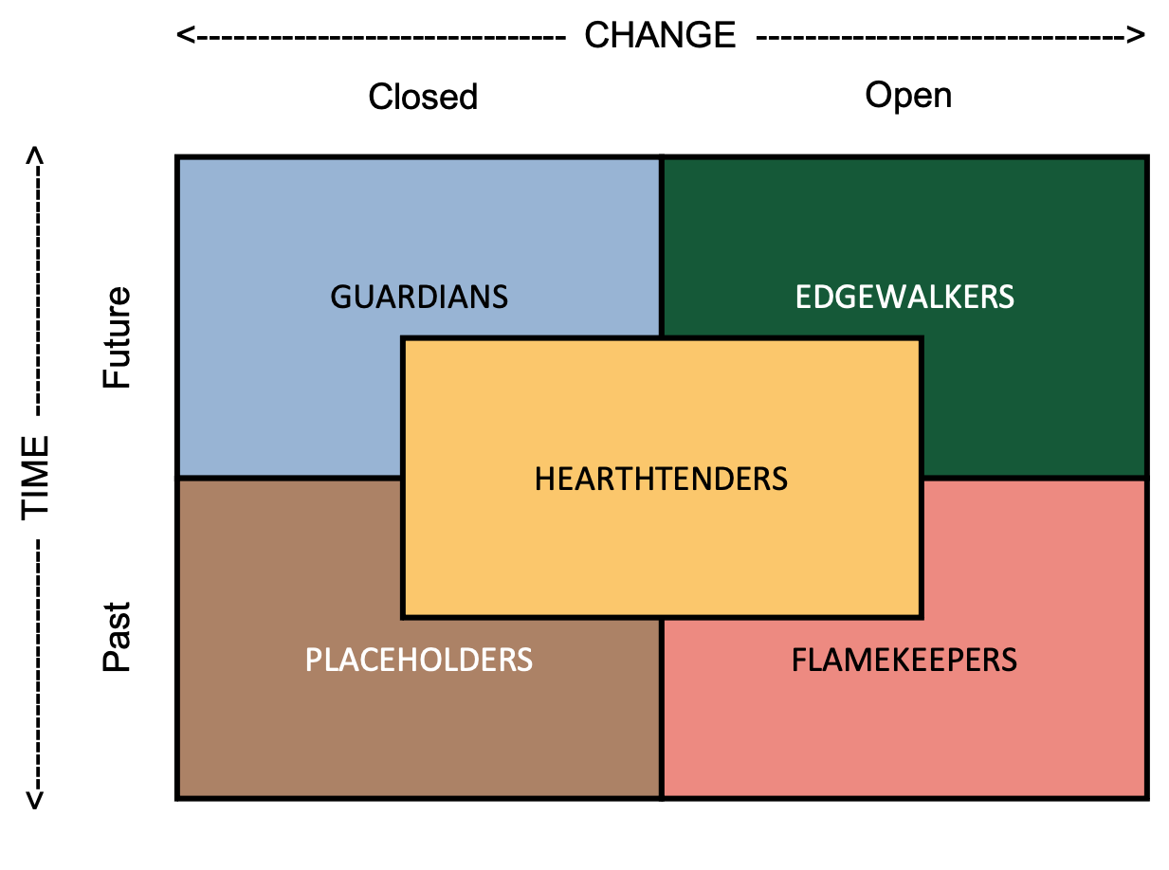
Archetypes of Change
Research-based
Transformation model
Five archetypes
Honoring differences

Slide 14
Archetypes of Change Model

Slide 15
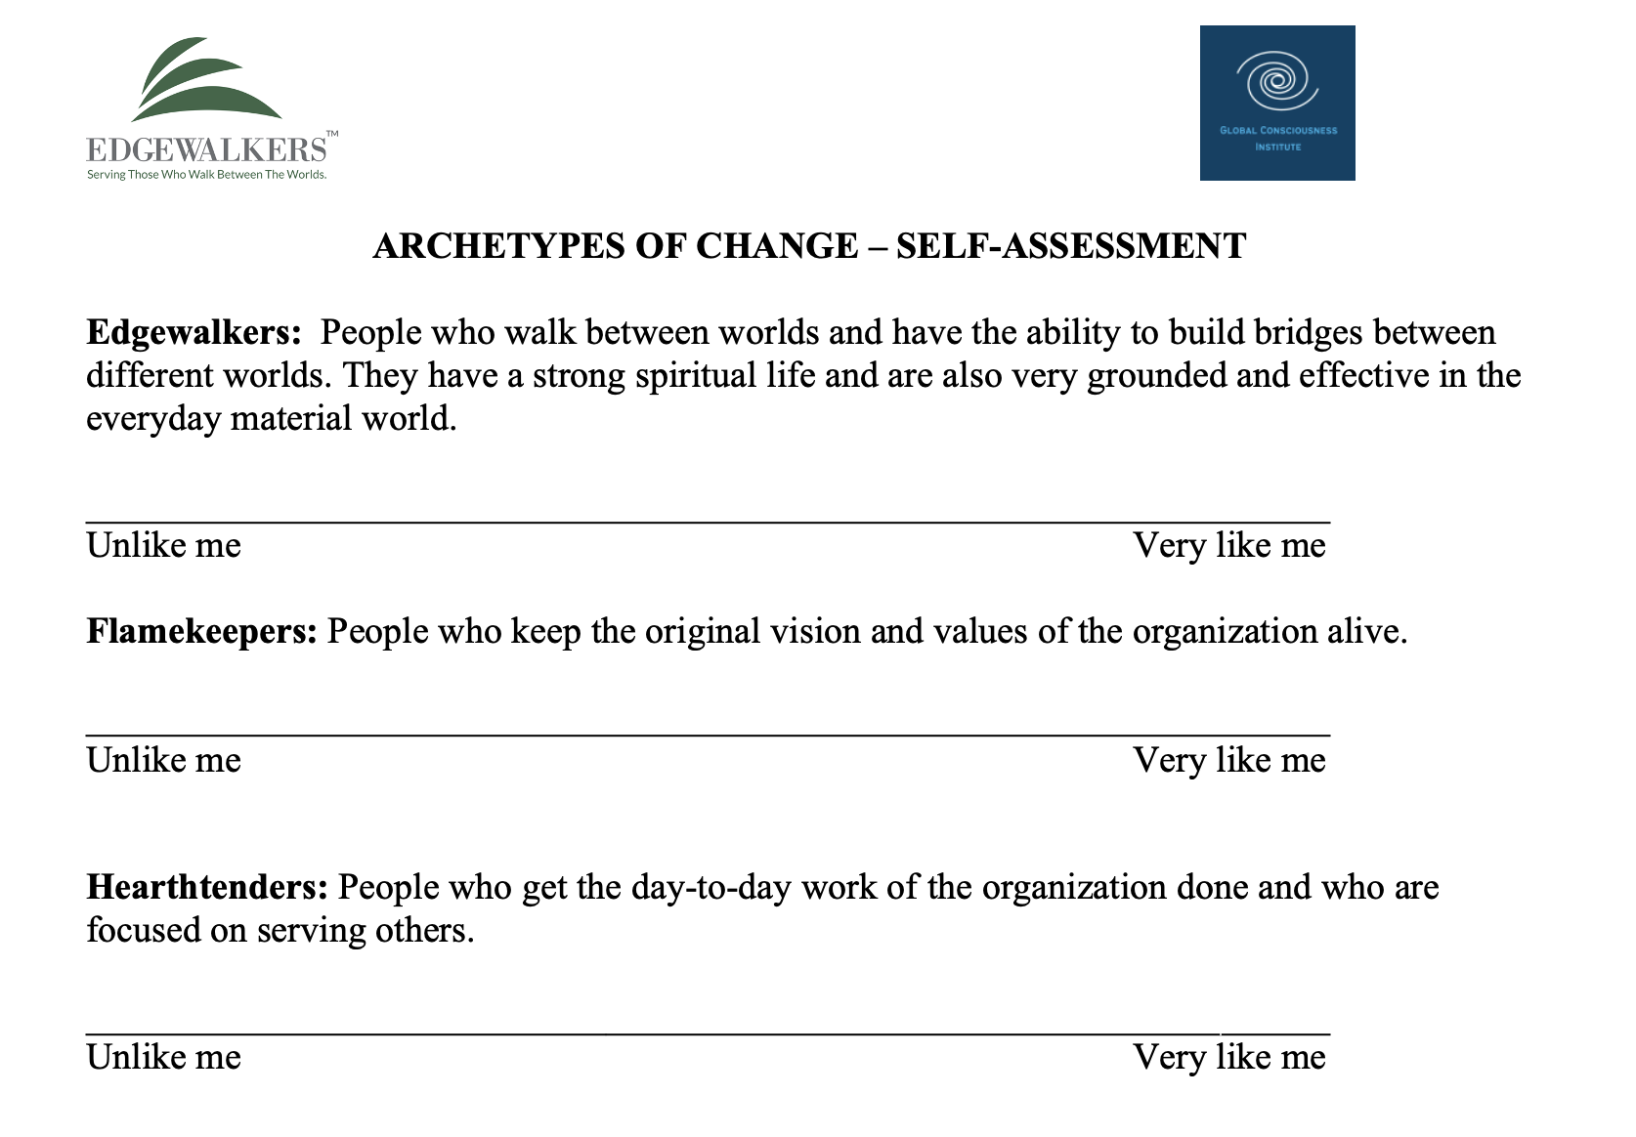
Archetypes Self-Assessment

Slide 16

Edgewalker
Future oriented
Open to change
Walks between worlds
Builds bridges
Strong inner life
Grounded and effective

Slide 17

Flamekeeper
Preserve the past but build on it
Open to change
Keep founding vision alive
Values-centered

Slide 18
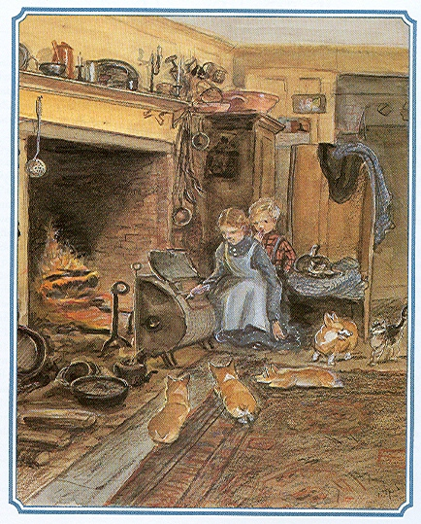
Hearthtender
Focus on the present
Moderately open to change
Commitment to service
Keeps home fires burning
Efficiency
Sense of family

Slide 19

Placeholder
Focus on the past
Prefers stability to change
Values doing over dreaming

Slide 20
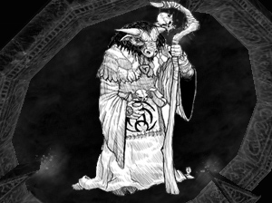
Guardian
Forebodings about the future
Fearful of change
Prevention and protection

Slide 21
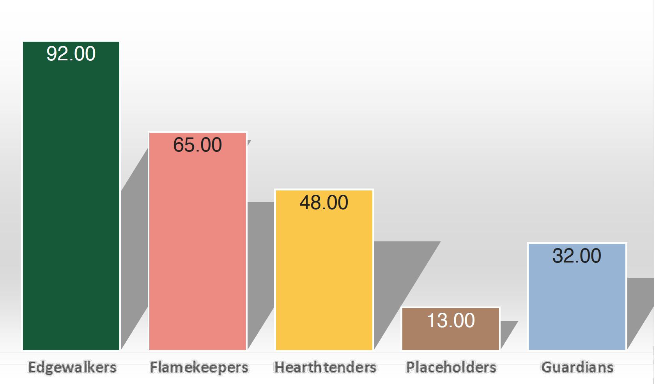
Edgewalker Archetype
Joanne Teh

Slide 22
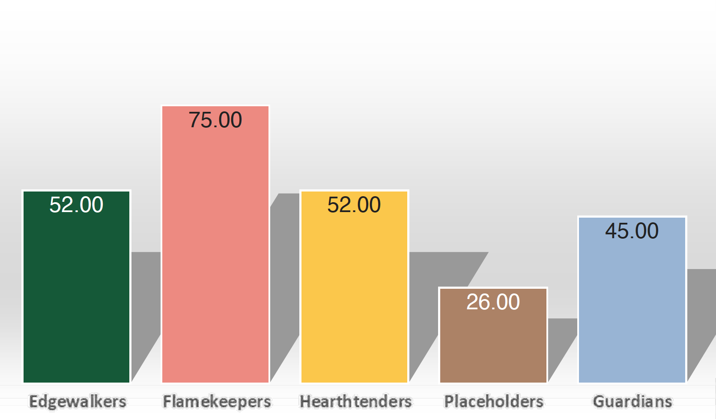
Flamekeeper Archetype
Alice Ong

Slide 23

Archetype Groups –
Select a scribe (2 minute report out)
What are the strengths or gifts of your primary archetype in the face of internal and external changes in your organization?
What are the shadow sides or challenges of your archetype that might hinder movement towards your organization’s desired future?

Slide 24
Archetypes – Report out
Strengths and Shadows (see report)
  Edgewalkers (10)
  Edgewalker/Hearthtenders (10)
  Flamekeepers (5)
  Hearthtenders (8)
  Placeholders (1)*
  Guardians (1)*
  Even (6)
  *Ivy Chia, Kam Qiang Wei, Dexter Say, Chris Laszlo

Slide 25
Breakout– By Organization
Select a scribe (2-minute report out)
Revisit Forcefield Analysis or Sustainability Impact Project
Share your Archetypes
Discuss the gifts of your strongest Archetypes in creating the desired future of your organization.
Is any Archetype missing that might be needed?

Slide 26
Breakout – Report out
What came out of your conversation?
What might you do next with this Archetype exploration?

Slide 27
Working with the Archetypes
Honor that each Archetype brings a valuable perspective. Listen for their wisdom.
Amplify the strength of each Archetype.
Compassion for the shadow (usually fear-based) side of each Archetype.
Most organizations marginalize Edgewalkers
Most development and education programs develop the other Archetypes

Slide 28
Working with the Archetypes
When contemplating a change, ask yourself, “How would an Edgewalker see this? How would a Flamekeeper see this?” etc.
Map the organization
  Online assessment
  Self-assessment sheet
  Draw maps and compare
Higher-Self Contemplation

Slide 29

Exercise: Archetypes Wisdom Council
Five volunteers + scribe
Challenge: AI Large Language Models
Each Archetype talks about the challenge (2 mins)
Switch chairs – take on new worldview
Discuss

Slide 30
Wisdom Council Discussion
What did you notice about yourself and your energy as you took on each Archetype of Change role? What was easiest? What was hardest?
What did you hear from others in the circle that inspired you?
What surprised you?
Where is the resistance, and how can it be honored? Can it be transformed? If so, how?
How might these insights lead to action to move the change forward?

Slide 31
Observer Discussion
What did you notice about yourself and your energy as you listened to Archetype of Change sharing? Which did you resonate with the most? The least? Why?
What did you hear from members in the circle of five that inspired you?
What surprised you?
Where is the resistance, and how can it be honored? Can it be transformed? If so, how?
How might these insights lead to action to move the change forward?

Slide 32

Use the Archetypes of Change Self-Assessment with organization members who are involved in planning and/or implementing desired changes.
Offer a workshop on the Archetypes of Change to organization members who are involved in planning and/or implementing desired changes. (The best way to learn is to teach.)
Share your Force Field Analysis with organization members who are involved in planning and/or implementing desired changes and ask for their input. Remember that amplifying the forces for change is more effective than trying to overcome the forces resisting change.
Conduct the Wisdom Circle Exercise with relevant members of your organization.

Slide 33
Global Consciousness Institute
Partnering with Octave
The mission of GCI is to bring to life the integration of modern science and living wisdom for a collective and systemic way of being, in service of the circle of life. Our mission is to reclaim this wisdom and bring it into higher education, to the workplace, and to communities.
Applied research, Quantum leadership, mapping the terrain, movement building
GCI newsletter
www.gci.earth

Slide 34
Edgewalkers International
A global community of people who walk between worlds and build bridges for the common good.
Edgewalker Newsletter
Edgewalker Cafes
Edgewalker Profile
Archetypes of Change - Organizational
judi@Edgewalkers.org

Slide 35
When you are inspired by some great purpose,
some extraordinary project,
all your thoughts break their bonds;
you mind transcends limitations,
your consciousness expands in every direction,
and you find yourself in a new,
great and wonderful world.
Dormant forces, faculties and talents become alive, and you discover yourself to be a greater person by far than you ever dreamed yourself to be.
Patanjali (150 BCE)

Slide 36
